Slide 1
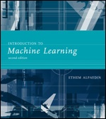
INTRODUCTION TO Machine Learning 2nd Edition
Lecture Slides for
ETHEM ALPAYDIN
© The MIT Press, 2010
alpaydin@boun.edu.tr
http://www.cmpe.boun.edu.tr/~ethem/i2ml2e

Slide 2
CHAPTER 10: Linear Discrimination

Slide 3
Likelihood- vs. Discriminant-based Classification
Likelihood-based: Assume a model for p(x|C_{i}), use Bayes’ rule to calculate P(C_{i}|x)
g_{i}(x) = log P(C_{i}|x)
Discriminant-based: Assume a model for g_{i}(x|Φ_{i}); no density estimation
Estimating the boundaries is enough; no need to accurately estimate the densities inside the boundaries

Slide 4
Linear Discriminant
Linear discriminant:
Advantages:
Simple: O(d) space/computation
Knowledge extraction: Weighted sum of attributes; positive/negative weights, magnitudes (credit scoring)
Optimal when p(x|C_{i}) are Gaussian with shared cov matrix; useful when classes are (almost) linearly separable

Slide 5
Generalized Linear Model
Quadratic discriminant:
Higher-order (product) terms:
Map from x to z using nonlinear basis functions and use a linear discriminant in z-space

Slide 6
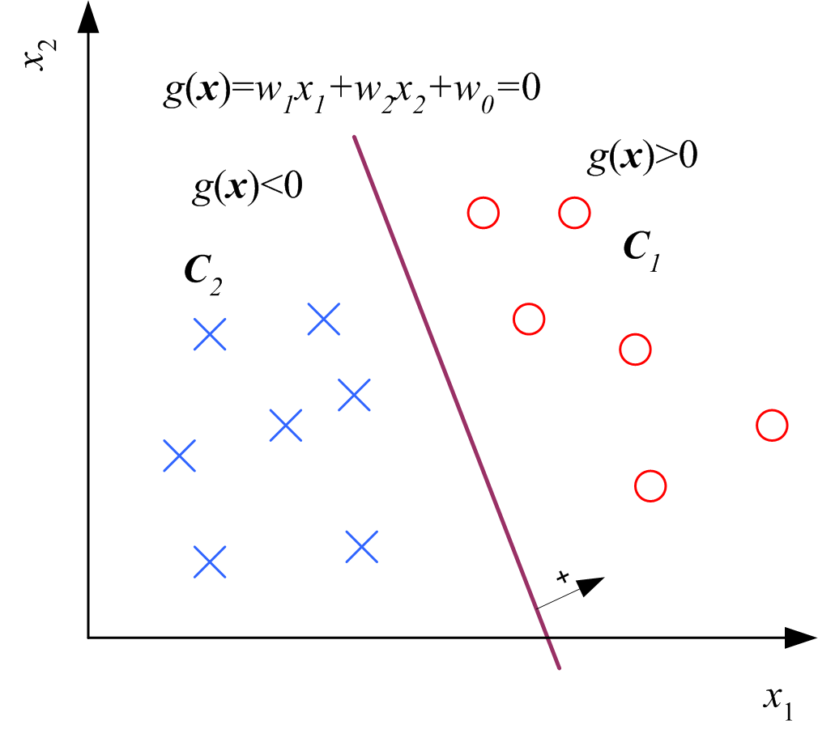
Two Classes

Slide 7
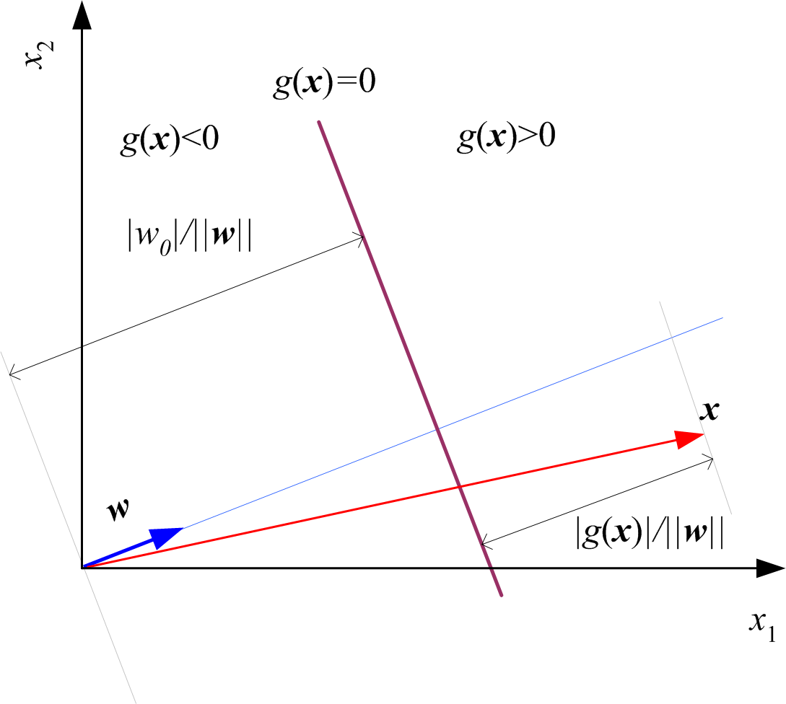
Geometry
r₀
r

Slide 8
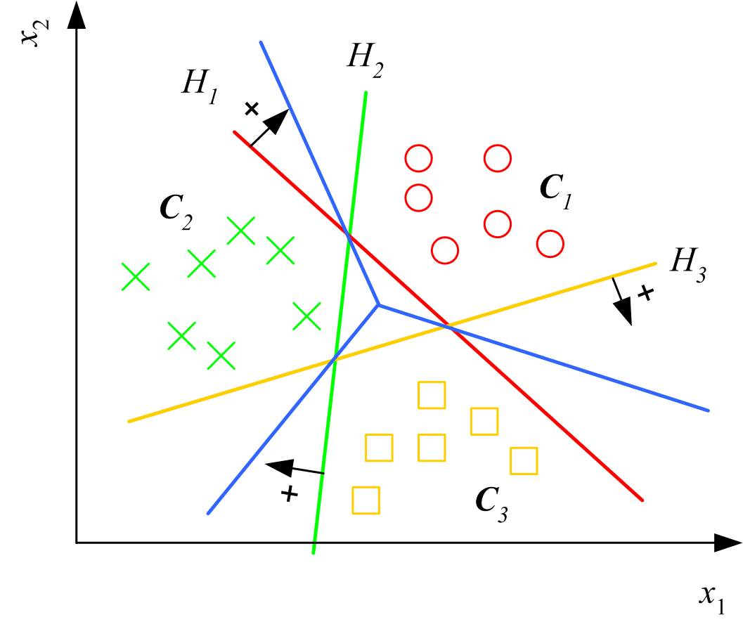
Multiple Classes
Classes are
linearly separable

Slide 9
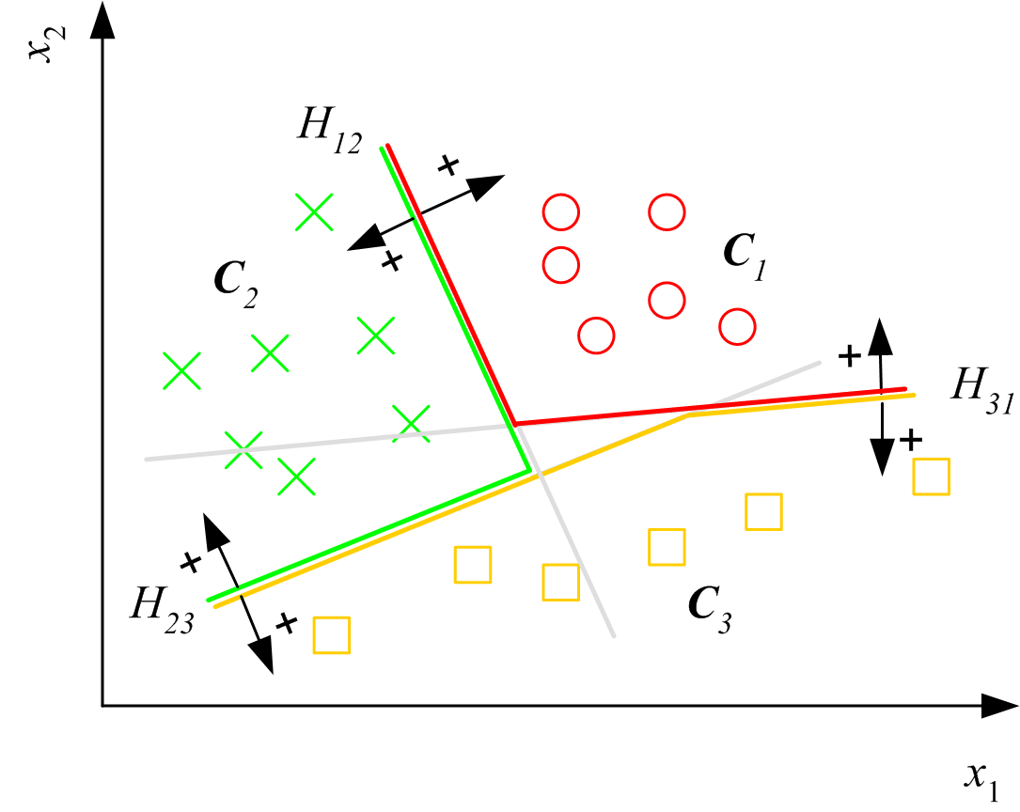
Pairwise Separation

Slide 10
From Discriminants to Posteriors
When p (x | C_{i} ) ~ N ( μ_{i} , ∑)

Slide 12
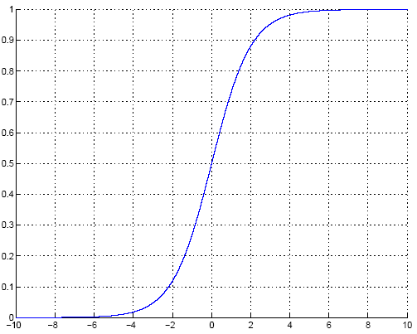
Sigmoid (Logistic) Function

Slide 13
Gradient-Descent
E(w|X) is error with parameters w on sample X
w*=arg min_{w} E(w | X)
Gradient
Gradient-descent:
Starts from random w and updates w iteratively in the negative direction of gradient

Slide 14
Gradient-Descent
E (w^{t})
E (w^{t+1})
w^{t}
w^{t+1}
η

Slide 15
Logistic Discrimination
Two classes: Assume log likelihood ratio is linear

Slide 16
Training: Two Classes
Cross Entropy

Slide 17
Training: Gradient-Descent

Slide 18
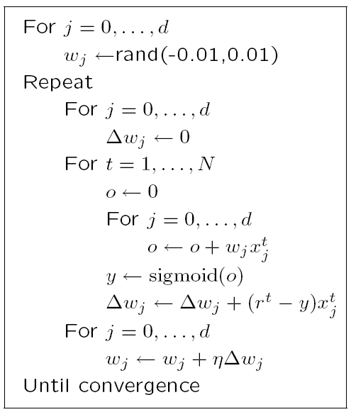

Slide 19
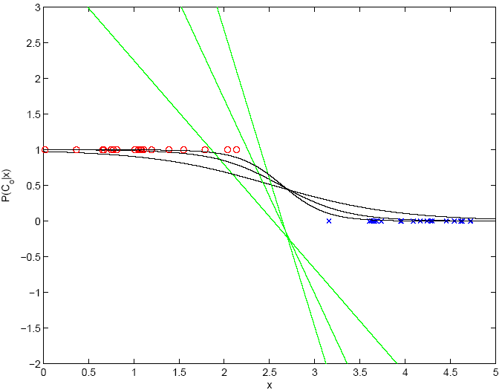
100
1000
10

Slide 20
K>2 Classes
softmax

Slide 21
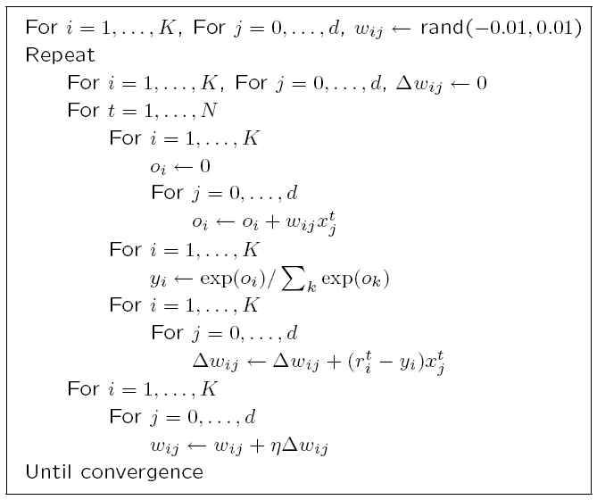
Notes:
We choose initial w small, so that we start with a hyperplane around the origin and we can move it to where it needs to be iteratively.
If w was initialized large, could be stuck in a far away local minima then the optimal w.

Slide 22
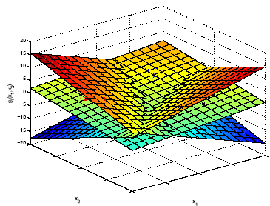
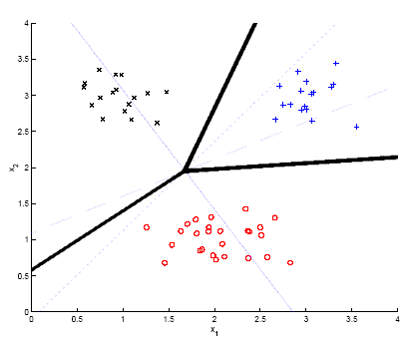
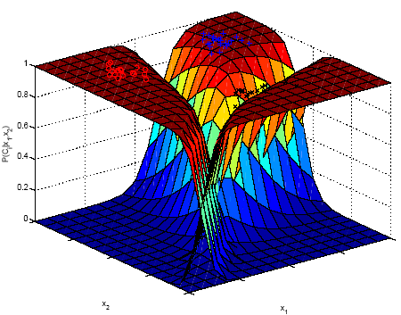
Example

Slide 23
Generalizing the Linear Model
Quadratic:
Sum of basis functions:
where φ(x) are basis functions
Hidden units in neural networks (Chapters 11 and 12)
Kernels in SVM (Chapter 13)

Slide 24
Discrimination by Regression
Classes are NOT mutually exclusive and exhaustive

